Slide 1

Efficient doctor patient management portal
Group 4

Slide 2

Group Members
Bharapaneedi Navya Sree
Harshitha . N
Gavireddy Sireesha
Lasya Pandeti
Gopika . P
This Photo by Unknown Author is licensed under CC BY-NC

Slide 3
Project Time Line
SRS Release
07/12/2022
Code
Implementation
08/12/2922
Integration testing
Planning and implementation
11/12/2022
Design
08/12/2022
Unit testing
Planning andImplementation
11/12/2022

Slide 4
Table Of contents
Understanding the problem statement
Coding and execution
Coding and Testing
Challenges Faced

Slide 5
1.
Understanding the
Problem statement

Slide 6
INTRODUCTION
The concept of “Efficient Doctor Patient Management Portal” is to reduce the difficulties faced by the patients and doctors while consultation . The patient can register to the system by providing their basic details and after that they can fix appointments by choosing the specialization and from the list of available doctors and available slot . The doctor can register to the system by providing their details and the available timings . The doctor portal contains various functionalities like view appointments , update patient medical history etc.

Slide 7
Objectives
Registration and login of doctor and patient.
Database to store the information given by the user
Query system to list all appointments carried out by a doctor
Slot booking facility for patients to consult doctor
Allowing doctor to record the medical history of a patient on the portal
Allowing Admin to add, modify or delete the patient and doctor data

Slide 8
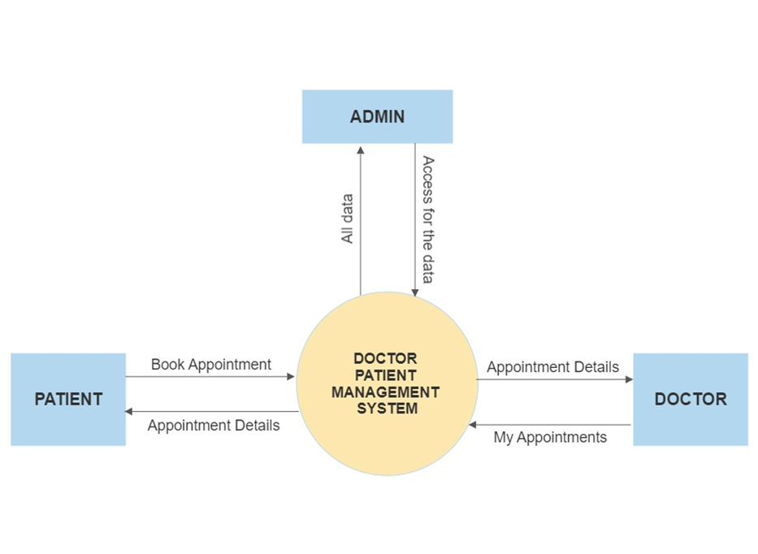
Low Level DESIGN

Slide 9
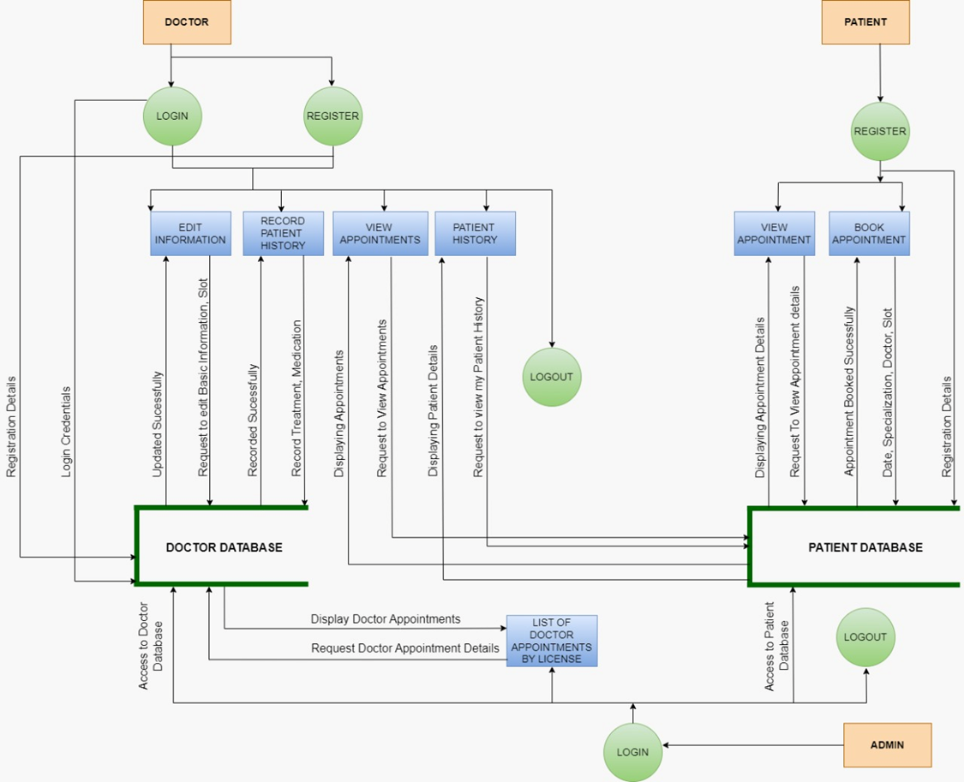
High level dESIGN

Slide 10
FLOW CHART
start
Main menu
Admin
Doctor
Patient
1.Add,edit,delete doctor details
2.Modify and delete
Patient details
1.Register
2.Enter slots
3.Recording patient history
4.Changing doctors basic information
1.Register
2.Selecting doctor with specialization he/she want
3.Selecting slot

Slide 11
Function description
doctor_registration()
This features helps doctors to register to the system by providing the personol information,specialization and the MCI registration number
view_booking()
It will help the doctor to view their appointments.
record_patient_history()
This function help the doctors to store the patient’s medical history like illness, prescription .
view_doctor_info()
Using this function doctor’s can view their personal profile
edit_doctor_info()
This will help the doctors to edit their personal details

Slide 12
Function description
View_patient_history():
This will help the doctors to view and reuse the patient data in future.
patient_registration():
Allows users to register to the system as patient.
Book_appointment():
Allow the patients to login to the system and fix the appointment.
Doctor_file_maintenance()
It will allow the admin to add, update and delete the doctors
Patient_file_maintenance():
It will allow the admin to maintain the patient records

Slide 13
Function description
Doctor_license_query():
It will allow the admin to search the doctors appointments with their mci license number
isalpha_validation1(char *str):
to validate name of doctor/patient/admin.
isdigit_validation1(char *str):
to validate mobile number, MCI licence number, Adhaar number
patient_list_to_file():
adding the patient list into file so doctor can be able to see the patient history
doctor_list_to_file();
This function is used to store the doctor’s details into a file

Slide 14
Function description
patient_list_to_file():
This function is used to store the patient’s details into a file
book_appointment_list_to_file();
This function is used to store the appointments details into a file
record_patient_history_list_to_file():
This function is used to store the patient’s medical history details into a file

Slide 15
2.
Coding And Execution
2

Slide 16
System Architecture
DOCTOR:
Register/login into the portal,
Can see the appointments,
Can see patients medical
history
PATIENT
Register/login to portal
Booking appointment
Doctor Patient Management
Portal
ADMIN
Can add,delete or modify doctors
And patient details

Slide 17
Portal functions
Regestering doctor, fixing slots,allocating patients to doctors, storing patients history
Registering patient , book doctor according to the specialization and availability
Modifying , adding,
deleting doctor details
Adding and deleting patient details

Slide 18
Coding and Testing

Slide 19
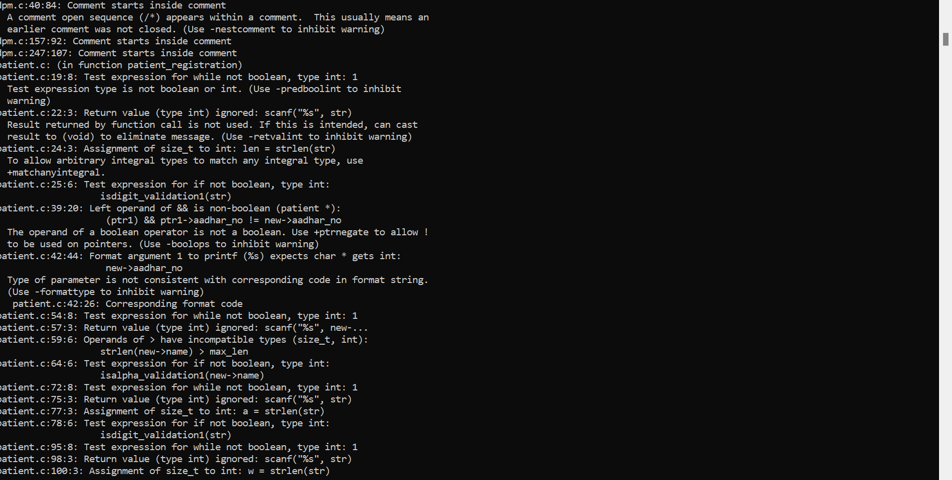
SPLINT TOOL REPORT

Slide 20
INTEGRATED TESTING

Slide 21
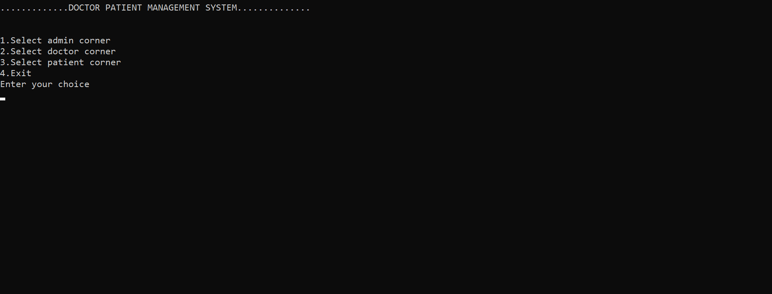
MAIN WINDOW

Slide 22
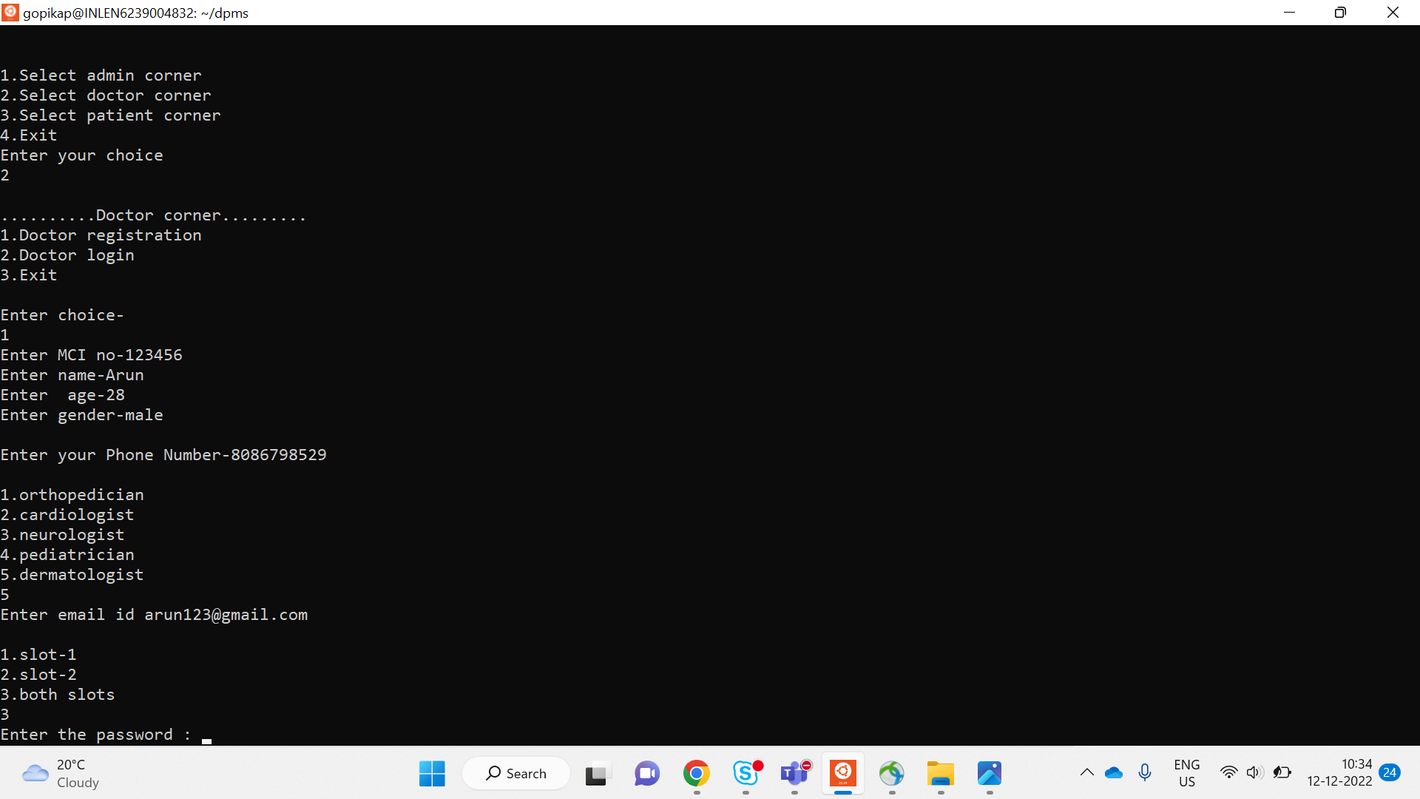
DOCTOR REGISTRATION

Slide 23
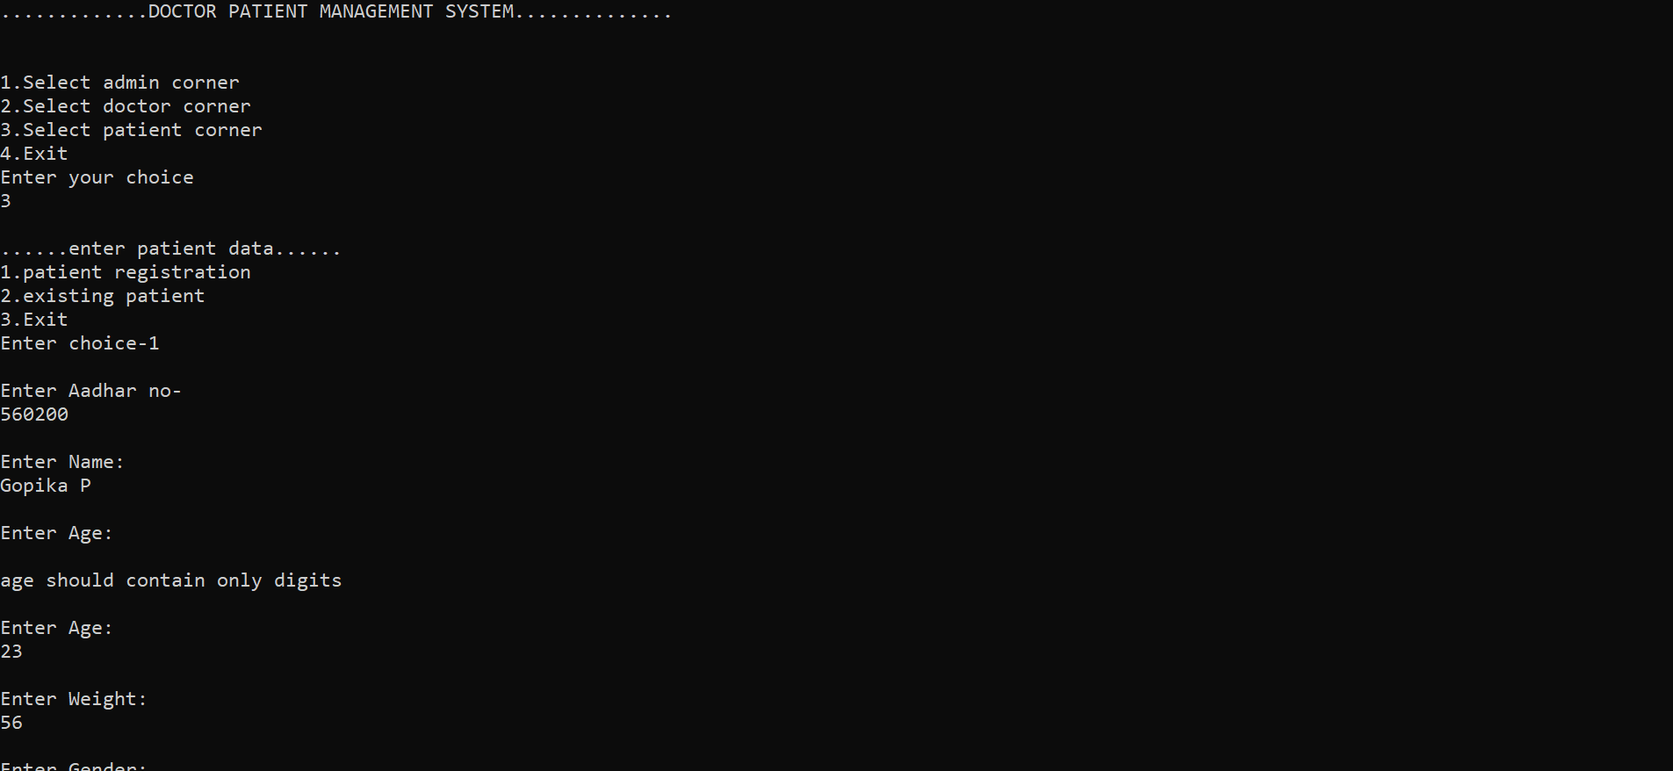
PATIENT REGISTRATION

Slide 24
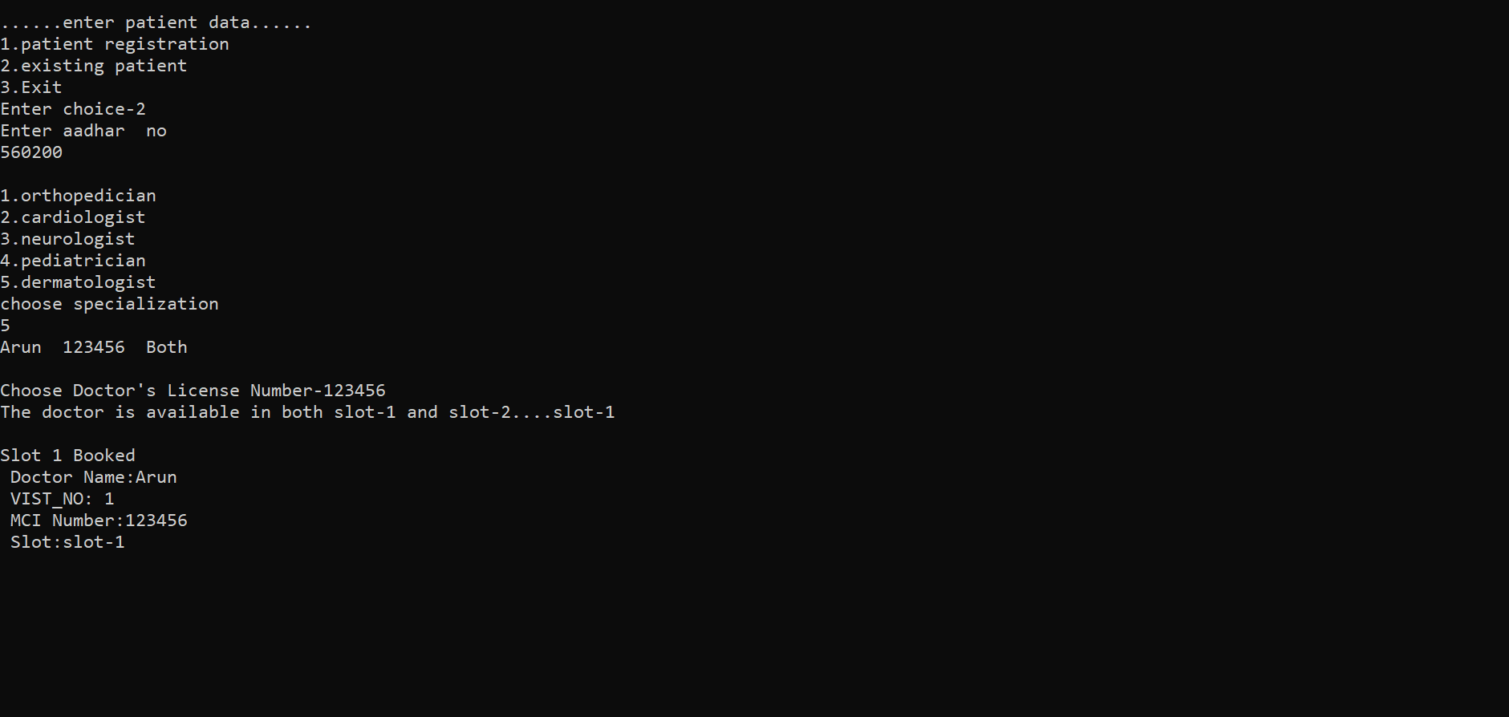
SLOT BOOKING

Slide 25
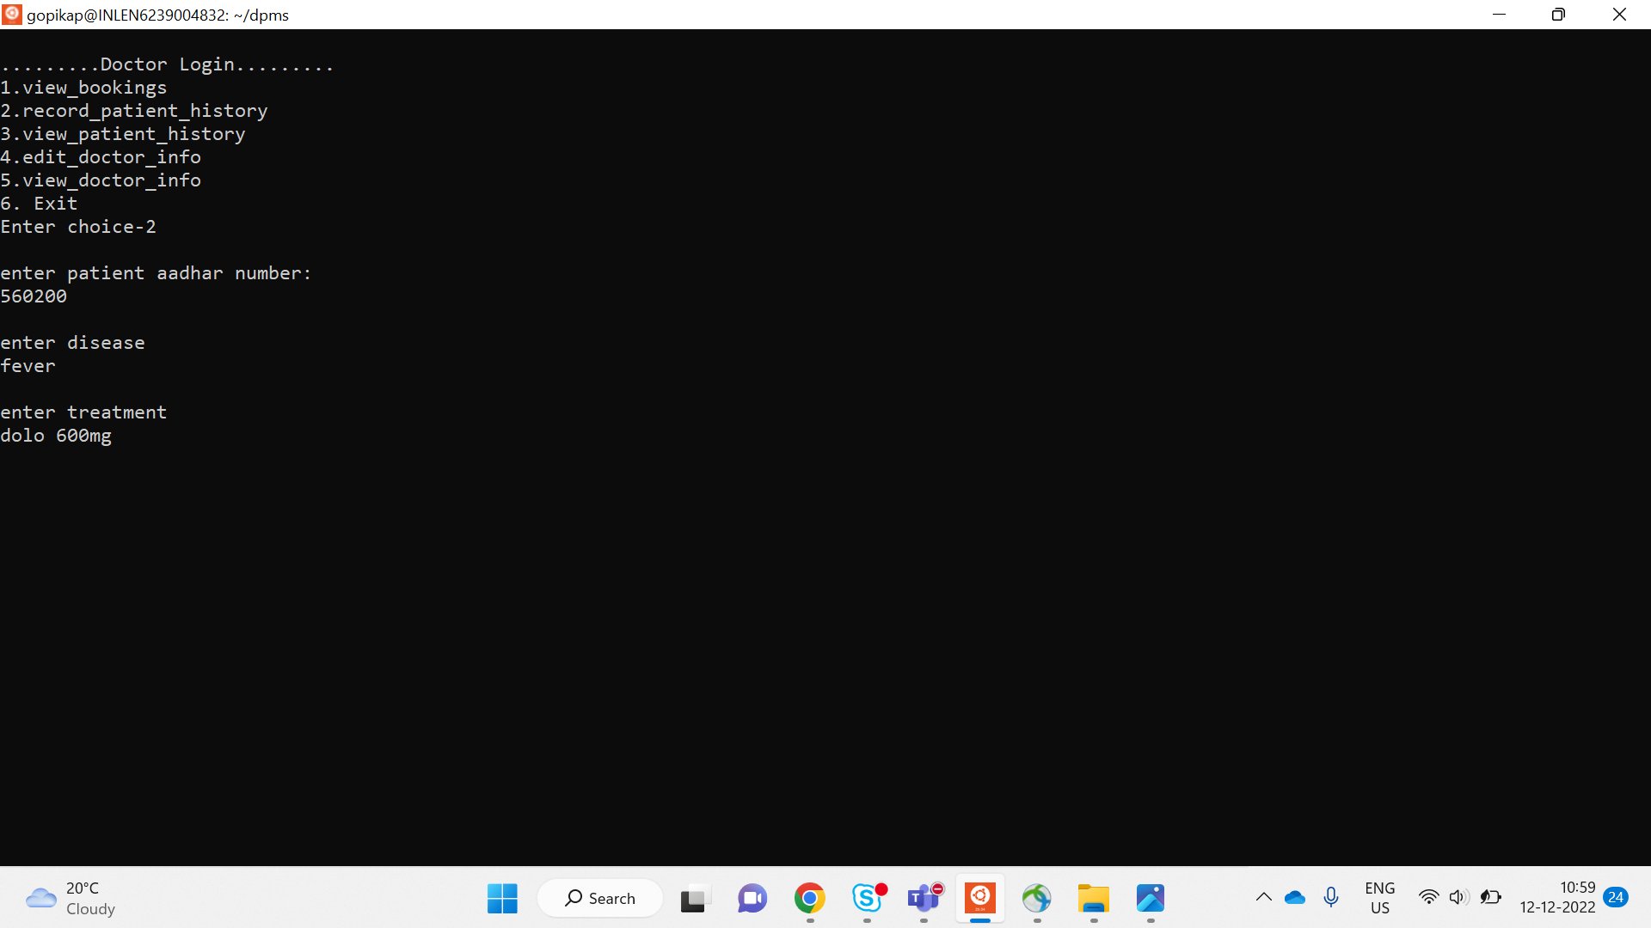
RECORD PATIENT MEDICAL HISTORY

Slide 26
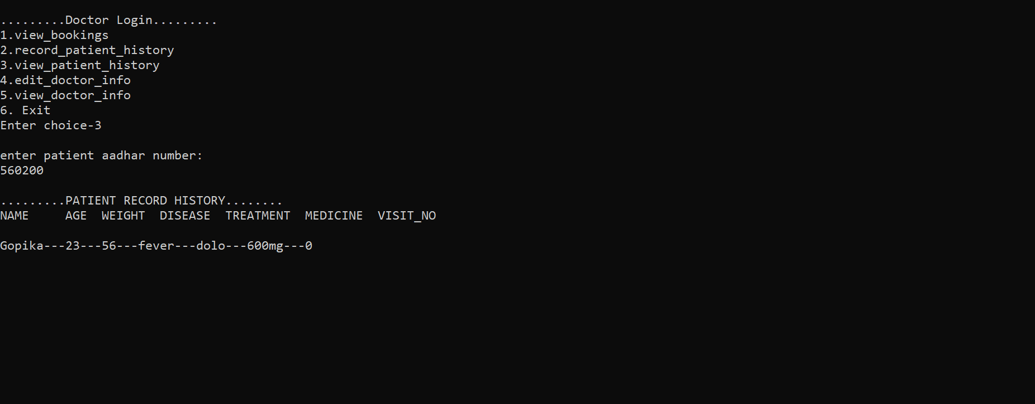
VIEW PATIENT HISTORY

Slide 27
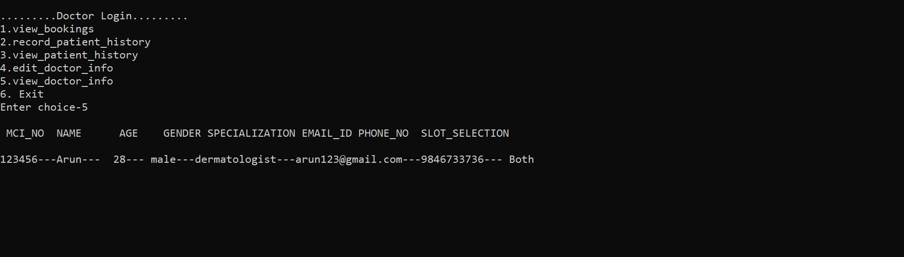
VIEW DOCTOR’S PROFILE

Slide 28
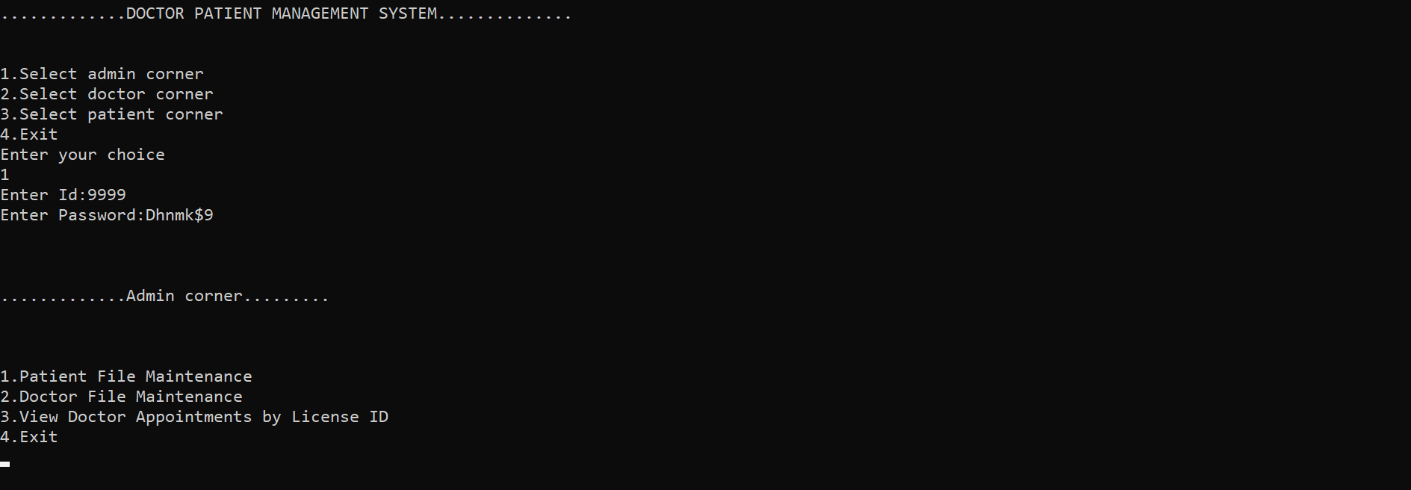
ADMIN PORTAL

Slide 29
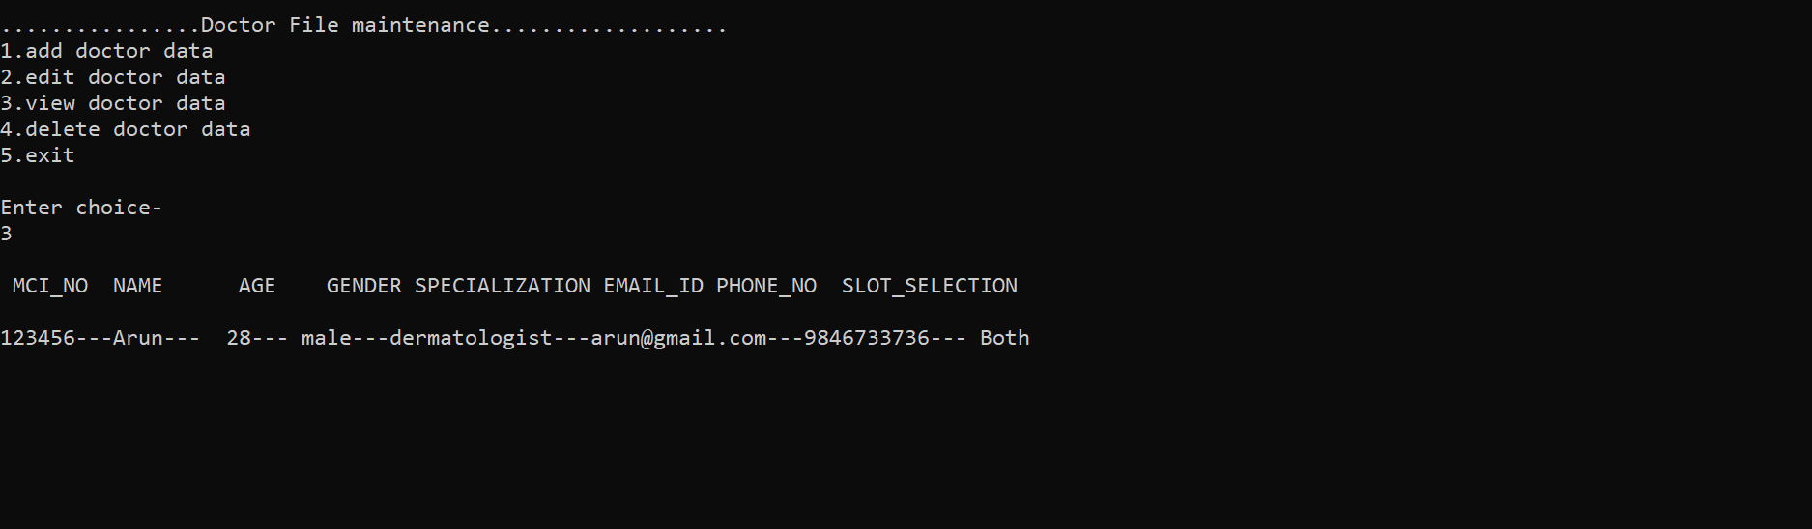
VIEW DOCTOR ‘S FROM ADMIN PANEL

Slide 30
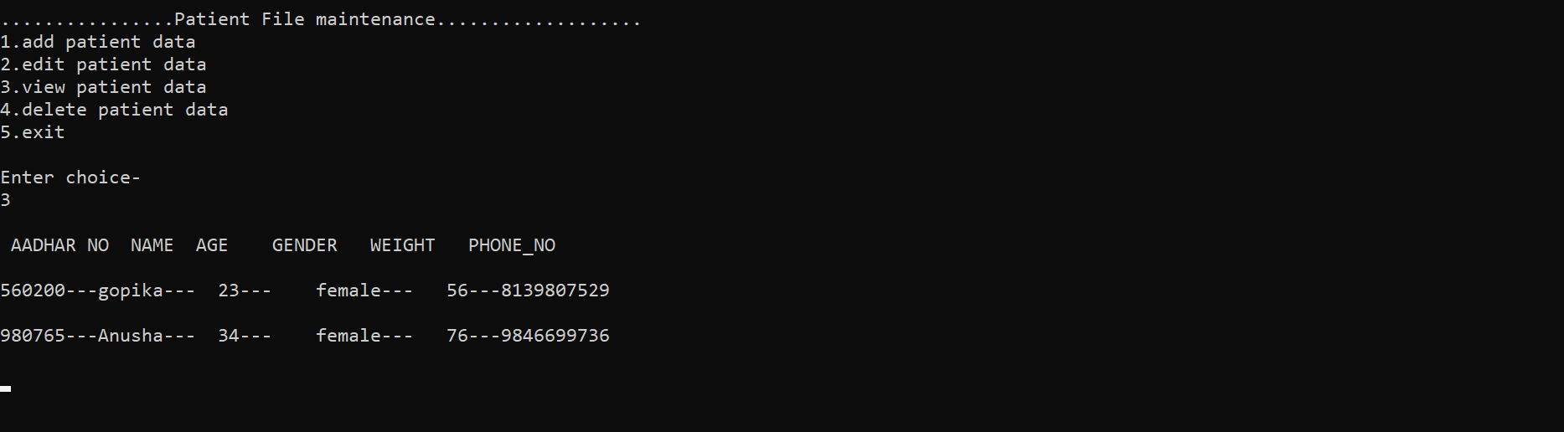
VIEW PATIENT DETAILS

Slide 31
Valgrind report

Slide 32
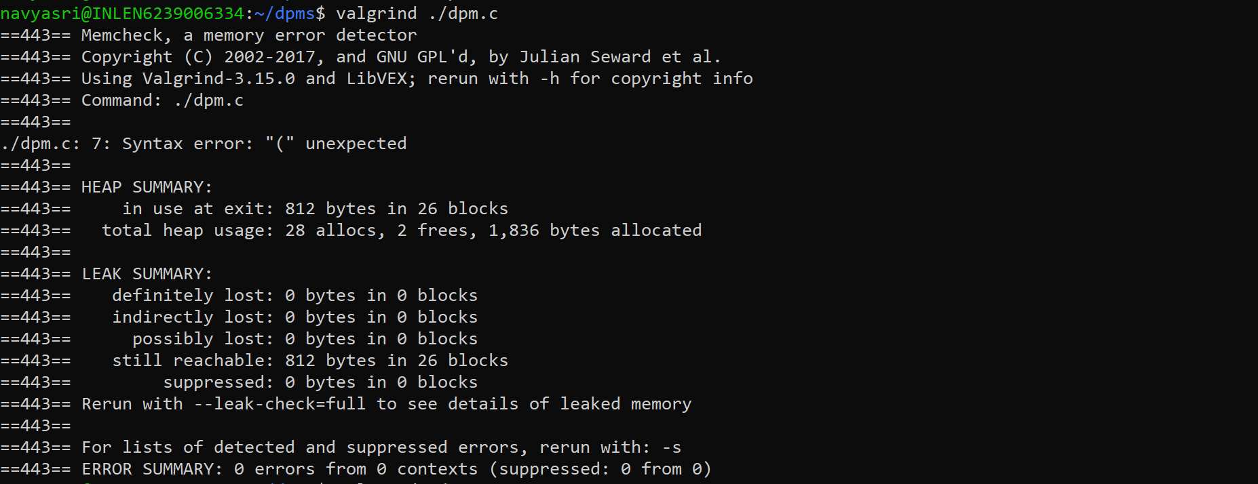

Slide 33
Challenges

Slide 34
Challenges faced
To decide which data structure would be best for the project
Setting and making login portal for Doctor and patient
Understanding and implementing unit testing and integration testing.

Slide 35
conclusion
Successfully completed the coding and testing phases as per the given problem statement.
Got the expected results for the efficient doctor patient management portal

Slide 36

Github Link:
https://github.com/PGopika/Group4

Slide 37

ANY QUESTIONS?
This Photo by Unknown Author is licensed under CC BY-NC

Slide 38


